Slide 1
Luke Patch Flextrack T1A3 terminal app
Introduction
The intention of this project and application is to fullfil the guidelines of the final assignement of term 1 of the Flextrack boot camp.

Slide 2
Project Scope
1.Project needs- The application will be a terminal based text role playing game in the format of the “Choose Your Own Adventure” books. This will be implemented using the Ruby programming language.
2.Objective and goals-As per instroduction. The goals of this application will be based on the SMART principle (Specific, Measurable, Realistic and completed in the allocated Timeframe).
This a text based terminal game in the style of the choose your own adventure books. The story is based lossley on Tolkien’s works and is set in his Middle Earth from the Lord of The Rings and Hobbit books.

Slide 3
Control flow
Mirkwood_Game.rb
Story.rb
Story2.rb
Story3.rb
Story4.rb
Story5.rb
Story6.rb
Story7.rb
Story8.rb
Story9.rb
GAME OVER
Story10.rb

Slide 4
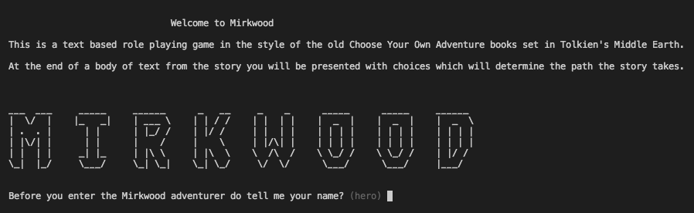

Slide 5
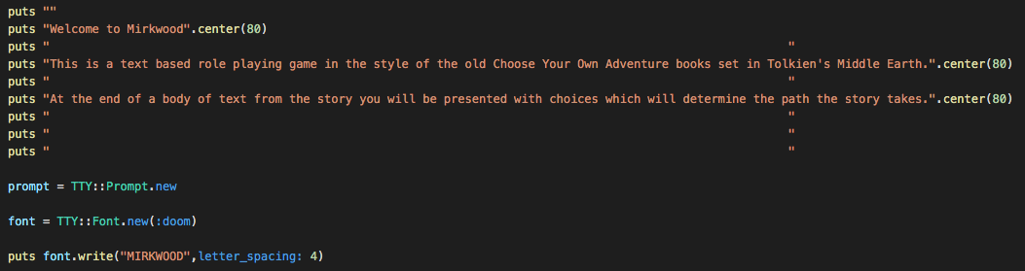

Slide 6
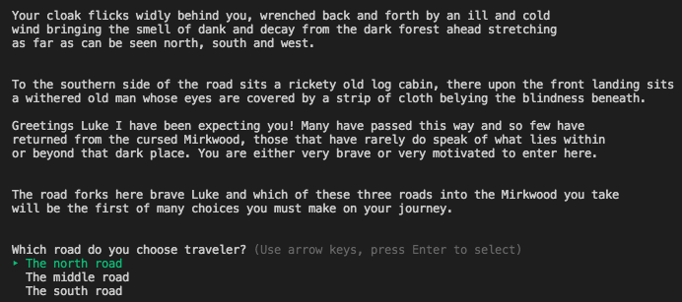

Slide 7
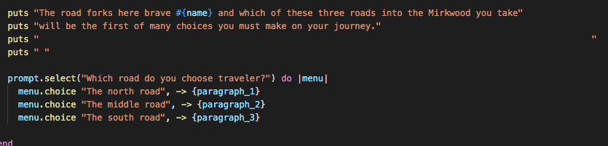

Slide 8
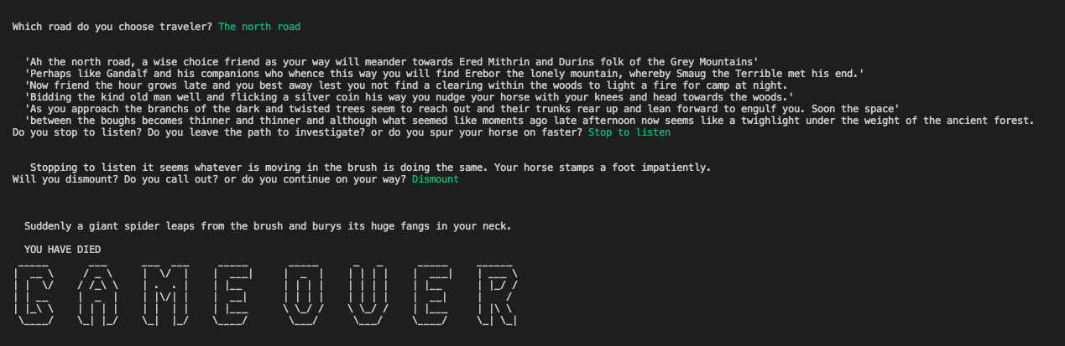

Slide 9
